Slide 1

Java 11 – New Features
Dima Ionut Daniel

Slide 2
Contents
What is Java?
History
Java Flavors
New Features
Lambda Parameters
Epsilon GC
ZGC
HTTP Client API
Other Improvements
Bibliography

Slide 3

What is Java?
Java is a programming language created by Sun Microsystems.
Java is used in a wide variety of computing platforms from embedded devices and mobile phones on the low end, to enterprise servers and supercomputers on the high end.
Memory management is handled through integrated automatic garbage collection performed by the JVM.
The heart of the Java platform is the concept of a "virtual machine" that executes Java bytecode programs. This bytecode is the same no matter what hardware or operating system the program is running under.
There is a JIT(Just-In-Time) compiler within the Java Virtual Machine, or JVM. The JIT compiler translates the Java bytecode into native processor instructions at run-time and caches the native code in memory during execution.
The Java programs are cross-platform or platform independent, but the code of the Java Virtual Machines (JVM) that execute these programs is not.

Slide 4
History
The initial Java release was named Oak, and the first stable version was JDK 1.0.2, called Java 1.
JDK 1.0 - 23 January 1996
JDK 1.1 – 19 February 1997
J2SE 1.2 – 8 December 1998 (codename Playground)
J2SE 1.3 – 8 May 2000 (codename Kestrel)
J2SE 1.4 – 6 February 2002 (codename Merlin)
J2SE 5.0 – 30 September 2004 (codename Tiger)
Java SE 6 – 11 December 2006 (codename Mustang)
Java SE 7 – 7 July 2011(codename Dolphin)
Java SE 8 – 18 March 2014 (codename Spider)
Java SE 9 – 21 September 2017
Java SE 10 – 20 March 2018
Java SE 11 – 25 September 2018

Slide 5
Java Flavors
The Java distribution comes in different flavors:
Java Card →run securely on smart cards and similar small-memory devices.
Java ME(Micro Edition) → Specifies several different sets of libraries (known as profiles) for devices with limited storage, display, and power capacities.
Java SE(Standard Edition) → for general-purpose use on desktop PCs, servers and similar devices.
Java EE(Enterprise Edition) → Java SE plus various APIs useful for multi-tier client–server enterprise applications.

Slide 6
New Features
JEP 181: Nest-Based Access Control
JEP 309: Dynamic Class-File constants
JEP 315: Improve Aarch6 Intrinsic
JEP 320: Remove the Java EE and CORBA modules
JEP 321: Standard HTTP Client
JEP 323: Local-Variable Syntax for Lambda Parameters
JEP 324: Key Agreement with Curve25519 and Curve448

Slide 7
New Features (cont.)
JEP 327: Unicode 10
JEP 328: Flight Recorder
JEP 329: ChaCha20 and Poly1305 Cryptographic Algorithms
JEP 330: Launch Single-File Source Code Programs
JEP 331: Low-Overhead Heap Profiling
JEP 332: Transport Layer Security (TLS) 1.3
JEP 333: ZGC: A Scalable Low-Latency Garbage Collector (Experimental)
JEP 336: Deprecate the Pack200 Tools and API

Slide 8


Lambda Parameters
A lambda expression is an anonymous function that can accept input parameters and return a value.
A lambda expression can specify the types of all (or none) of its input parameters.
A lambda expression that explicitly specifies the type of all its input parameters is referred to as an explicitly-typed lambda expression.
In JDK 11, you'll be able to use var with lambda parameters.

Slide 9
Epsilon GC
JDK 11 introduces Epsilon garbage collector, to calculate how long will it take for the JVM to exhaust all its memory and shut down.
Epsilon is a no-operation(no-op) GC, it doesn't collect any garbage as it only handler the allocation of memory. When the available HEAP is exhausted, the JVM shuts down.
This GC has been added as a benchmark to test applications for performance, memory usage, latency and throughput improvements.

Slide 10
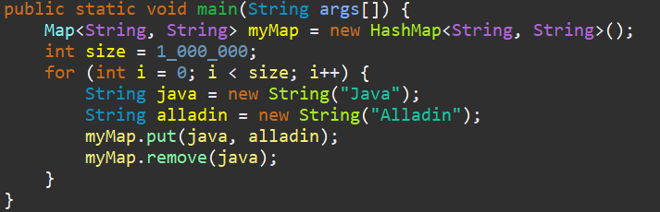
Epsilon GC (cont.)
Epsilon GC uses a simple lock-free Thread Local Allocation Buffer(TLAB) allocation.
Since it doesn't claim memory, it doesn't need to track the objects.

Slide 11
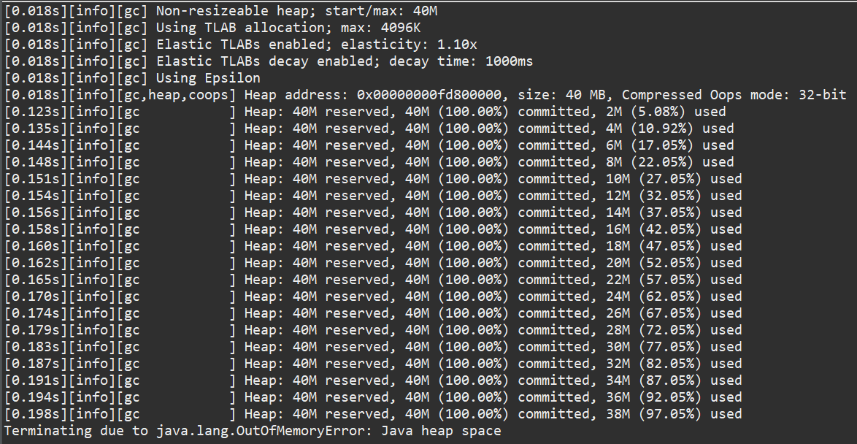
Epsilon GC (cont.)
java -XX:+UnlockExperimentalVMOptions -XX:+UseEpsilonGC -Xlog:gc* -Xmx40M EpMap

Slide 12
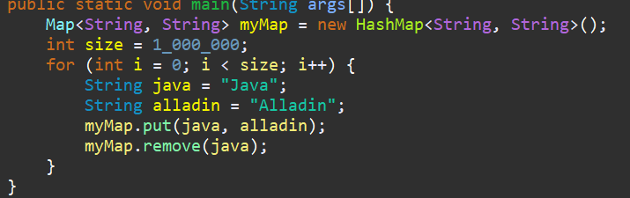
Epsilon GC (cont.)
We make a simple change in the java code, the 2 strings are not created, but taken from Java String pool and rerun the test.

Slide 13
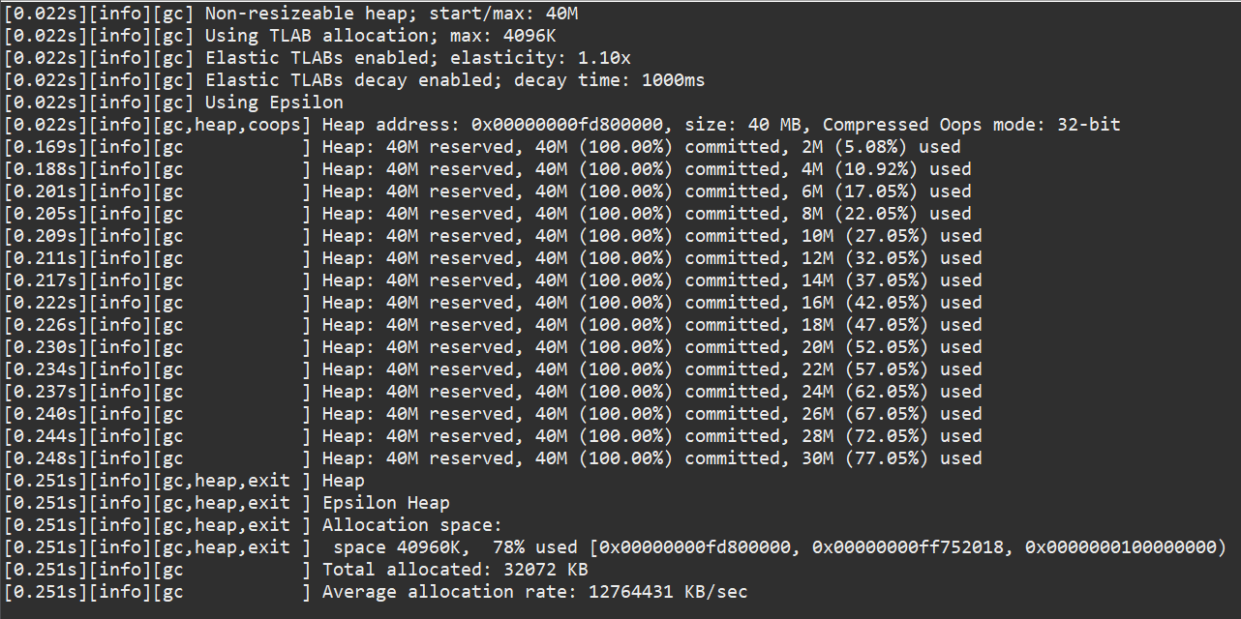
Epsilon GC (cont.)
java -XX:+UnlockExperimentalVMOptions -XX:+UseEpsilonGC -Xlog:gc* -Xmx40M EpMap

Slide 14
Epsilon GC (cont.)
Reducing garbage is just one of the solutions to out of memory errors.
A GC reclaims heap memory—which can include (non-local) primitive data types or objects.

Slide 15
ZGC
Z Garbage Collector(ZGC) is a new GC written from scratch.
It works with heap memory, ranging from JBs to larger TB memory.
As a concurrent GC, ZGC guarantees a latency by 10 ms, even for bigger heap sizes.
ZGC can mark memory, copy and relocate in a concurrently manner.
ZGC is a single-generation GC and supports partial compaction.

Slide 16
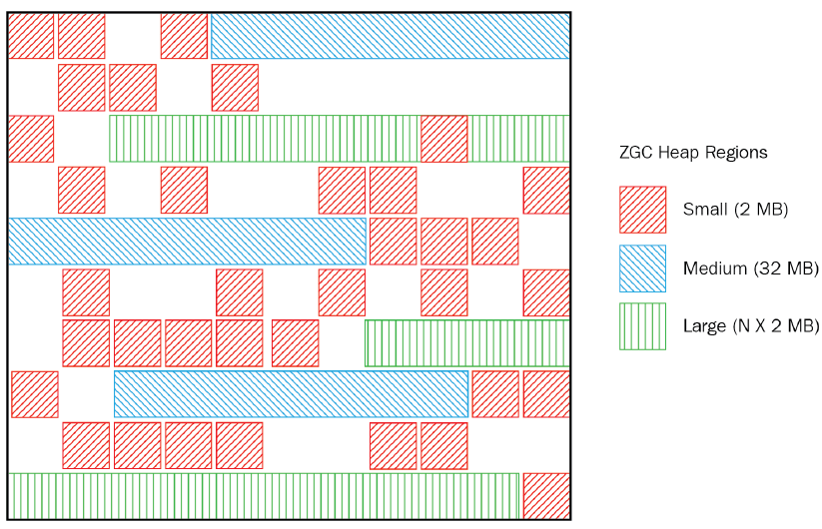
ZGC (cont.)
ZGC divides memory into regions called ZPages.
ZPages can be dynamically created and destroys.

Slide 17
ZGC (cont.)
Unlike other GCs, the physical heap regions of ZGC can map into bigger heap address spaces.
This can be crucial to combat memory fragmentation issues.
A GC cycle of ZGC includes multiple phases:
Pause Mark Start
Pause Mark End
Pause Relocate Start

Slide 18
HTTP Client API
With the HTTP Client API we can use HTTP/2 protocol in a non-blocking and asynchronous manner.
This bring a major improvement to the existing HttpURLConnection class that was added in Java 1.1.
HTTP Client was incubated in Java 9, with multiple modifications in Java 10 and was standardized in Java 11.
It resides in java.net.http package and module.

Slide 19
HTTP Client API (cont.)
HTTP Client API was incubated in Java 9 under jdk.incubator.httpclient package.
The incubated features was used explicitly in classpath.
HTTP Client API consists in 3 main classes/interfaces:
HttpClient class
HttpRequest class
HttpResponse interface

Slide 20

HTTP Client API (cont.)
Http Client uses reactive streams (BodyPublisher and BodySubscriber) to send an receive data streams in an asynchronous and non-blocking way.
To add custom settings, we can use the newBuilder() method, which follows the builder pattern.
If HTTP/2 protocol is not supported, the HttpClient instance default to HTTP/1.1.

Slide 21
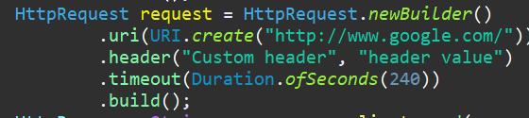
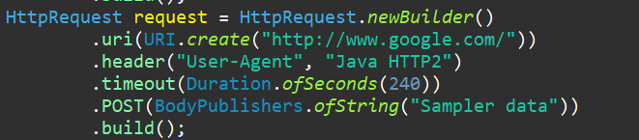
HTTP Client API (cont.)
The HttpRequest class encapsulates the information required to be sent across the network to the server. It includes the URI, set of headers, timeout, HTTP method, payload.
A request instance must include the HTTP method to use. If no method is specified, the GET request is used by default.

Slide 22
Other Improvements
JDK 11 enhances java.lang.String class with 6 new methods
boolean isBlank() - returns true if the string is empty or contains only white-spaces.
Stream<String> lines() - returns a stream of lines extracted from this string, separated by line terminators.
String repeat(int count) - returns a string whose value is the concatenation of this string’s repeated count times.
String strip() – returns a string whose value is this string, with all leading and trailing white-spaces removed.
String stripLeading() – returns a string whose value is this string, with all leading white-spaces removed.
String stripTrailing() – returns a string whose value is this string, with all trailing white-spaces removed.

Slide 23
Other Improvements (cont.)
java.nio.file.Files has new 4 static methods to read string from a file and write string into a file
static String readString(Path path) – reads contents from a file into a string, decoding from bytes to characters using the UTF-8 charset.
static String readString(Path path, Charset cs) – reads characters from a file into a string, decoding from bytes to characters using the specified charset.
static Path writeString(Path path, CharSequence csq, OpenOption… options) – writes a CharSequence to a file
static Path writeString(Path path, CharSequence csq, Charset cs, OpenOption… options) – writes a CharSequence to a file with the specified charset.

Slide 24
Other Improvements (cont.)
JDK11 enhances java.util.function.Predicate with a static not() method.
static <T> Predicate<T> not(Predicate<? super T> target) - returns a predicate that is the negation of the supplied predicate.
JDK11 new single-file launcher allows executing Java source codes directly using the java interpreter. The source code is compiled in memory and then executed by the interpreter. The limitation is that all the classes have to be defined in the same file.

Slide 25
Other Improvements (cont.)
Java 11 deprecated the following modules:
Nashorn JavaScript engine, including the JJS tool
Pack200 compression scheme for JAR files
JDK Mission Control(JMC) is no longer included in the JDK. A standalone version of JMC is available as a separate download.
The same is true for JavaFX modules.

Slide 26

Bibliography
http://en.wikipedia.org/wiki/Java_(programming_language)
https://examples.javacodegeeks.com/core-java/java-11-new-features-tutorial/
Java 11 and 12 new features
https://www.baeldung.com/java-11-new-features

